Slide 1
Broadband Satellite for Disaster Relief and Emergency Communications
6 May 2011
Taksin Upalagama
Director, Telco & Government Solution

Slide 2
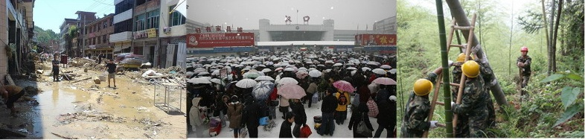
Situation: Not if, but when?
Natural and man-made disasters are a regular part of the global
landscape
Acts of violence and terrorism
Tsunamis and floods
Earthquakes and landslides
Hurricanes and severe weather systems
Volcanic eruptions

Slide 3
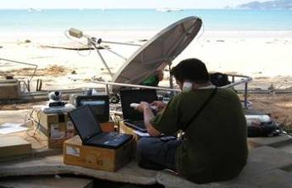
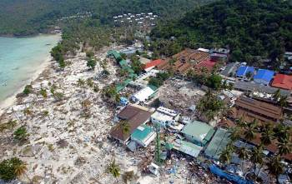
Impact and actions
… and can result in:
Loss of life or exposure to health risks
Breakdown of security and public order
Degradation of infrastructure and institutions (public & private)
Interruption of commerce and market confidence
Taking the lead:
International Relief and Humanitarian Organizations
Governmental agencies (Local & Federal)
Health & Medical Services
Financial Services

Slide 4
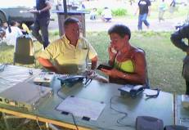
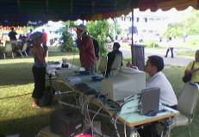
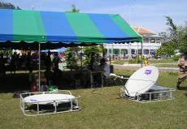
When Disaster Strikes – Facts
Communication outages caused by severe weather conditions, unexpected disasters and other telecommunication disruptions can occur in short notice and oftentimes without warning.
The time it takes to restore damaged telecommunication lines may require days or even weeks, leaving first responders crippled without access to reliable communications.
The lack of operable terrestrial infrastructure severely impedes the command and control functions, the situational awareness, and most importantly, the relief and recovery efforts of the first responders.

Slide 5
When Disaster Strikes – Key Requirements
First Responder and Emergency Manager (EM) Requirements
Staffing: trained, certified, distributed in affected zone
Logistics & Transport
Communications:
• Highly survivable, reliable, and secure networks
• Adaptive and readily available
• Mobile, rapidly deployable and scalable
• Integrated for horizontal and vertical connectivity
• Multi-media (voice, data, video) applications
• Seamless, region-wide support services

Slide 6
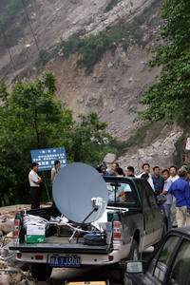
Advantages of Broadband Satellite for Disaster Relief
Broadband Satellite Systems can:
Fill the communication, command and control gaps as a result of crippled terrestrial networks.
Provide rapid, flexible disaster recovery and emergency communications in times of communication outages.
Meet the precise needs of first responder teams in putting communication networks back on line in the event of man-made or natural disasters.
Interconnect widely distributed systems and networks
Broadcast on-the-spot news
Deliver two-way, mobile telephone communications
Provide nationwide coverage and consistent Quality of Service (QoS), regardless of location

Slide 7

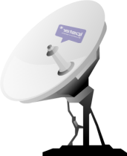

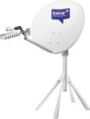








Satellite for “Network Redundancy and Diversity Concept”
Satellite is an important network overlay in the “Network Redundancy and Diversity Concept” for ‘critical’ traffic and usage
  Always-on system (not an inactive back-up)
  Typically contributes very little percentage to terrestrial network capacity, thus only for ‘critical’ traffic or ad-hoc use
GSM, CDMA, WiMAX
REDUNDANT
DIVERSITY
NETWORK
VSAT
IPSTAR
ADSL
CORE
NETWORK
Microwave
Wireless
Fixed Line
Fiber/
Copper
Copper, Fiber
7
03/05/54

Slide 8
Broadband Satellite Backup for Disaster and Emergency Communications
Emergency Command Center
For backup/redundancy network for “war room” communication to rescue workers and first responder teams, both command & control
Public Utility and Infrastructure Company
For backup/redundancy network to continue existing public services, i.e. train, plane, electricity, etc.
Telco, Enterprise and Government Offices
For backup/redundancy network to continue certain operations, i.e. mobile phone services, telco, military, police, TV broadcaster, etc.
Notes:
Example applications

Slide 9
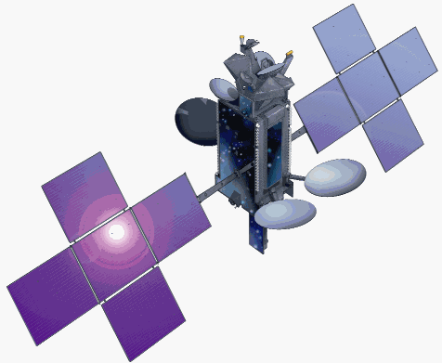
Summary
First Responders and Emergency Management need a satellite partner that:
Maintains a distributed Ground Operator Network throughout the Aisa-Pacific Region
Backs up its commitment for quality of service through a network of service providers
Can design and implement optimized networking solutions in
accordance with Customer specific requirements
Has strong international partners for seamless reach into other
technologies, markets and networks such as GSM Backhaul

Slide 10
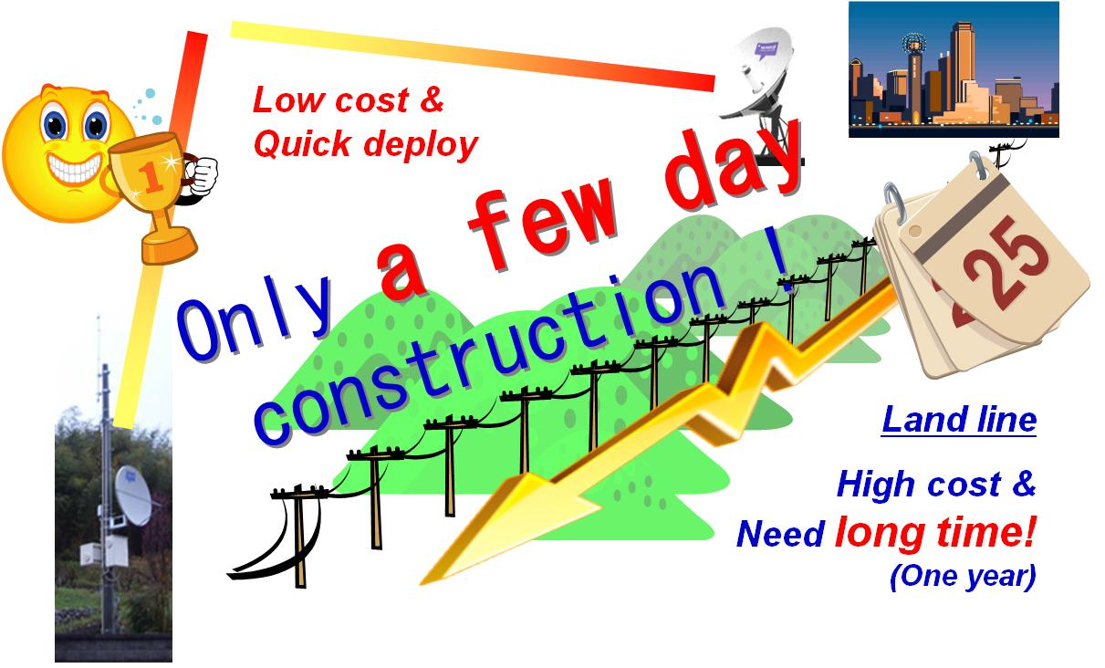
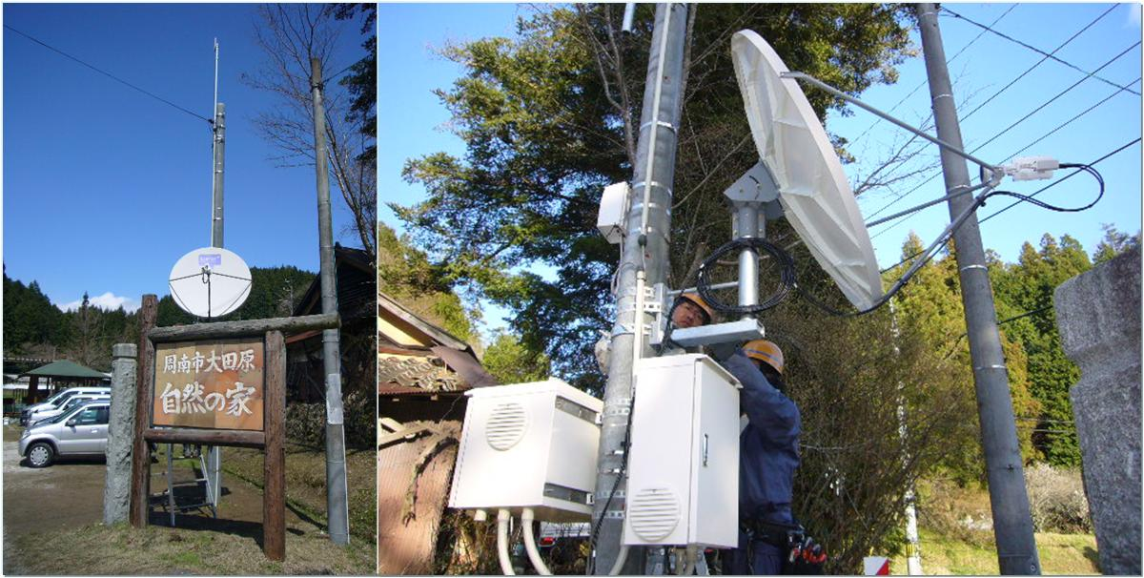
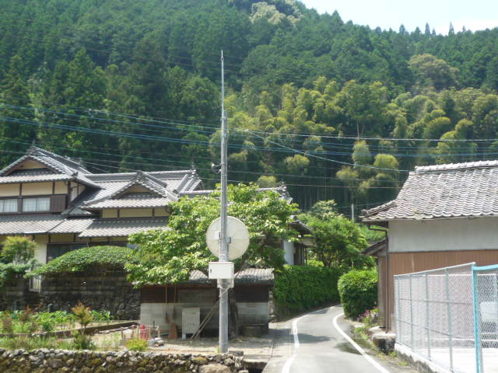
Femto Business Case:
Outdoor 3G/HSPA Femtocell + IPSTAR Deployment in Japan
Outdoor Femtocell as a Low Cost Base Station is an interesting business cases of using satellite in mobile phone industries. More than 3,000 sites is planned to deployed in Q2, 2011, with the 2 Gbps bandwidth utilization for voice and mobile broadband services.

Slide 11
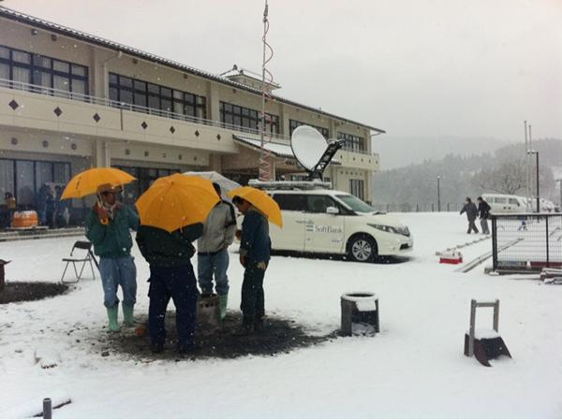
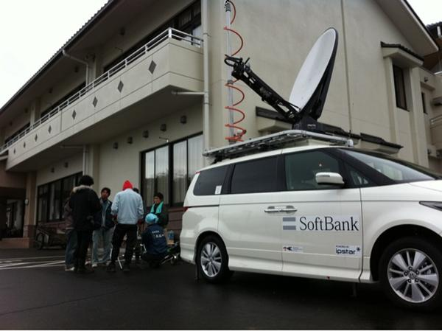
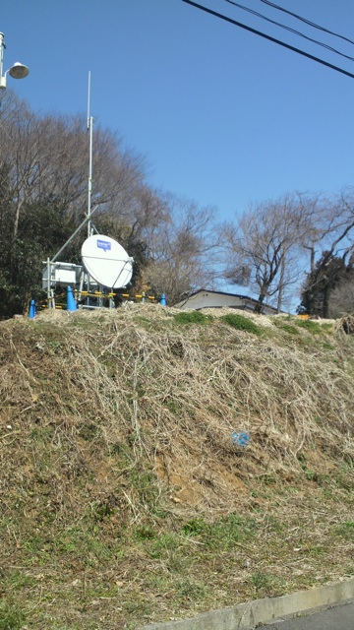
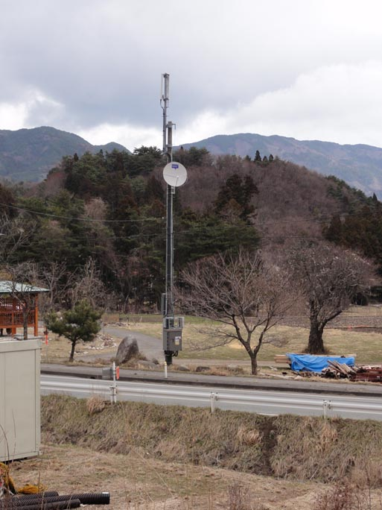
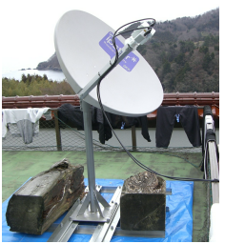
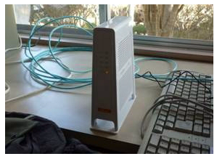
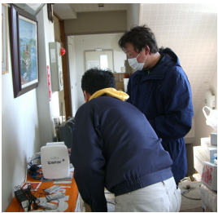
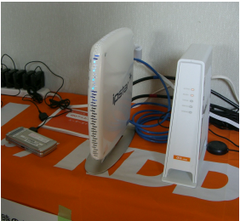
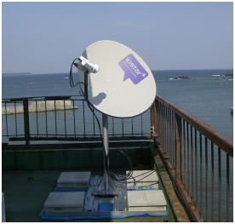
Japan’s Tsunami
IPSTAR with SBM use Femto cell and other BTS
SBM places order for 100 Mobile Antenna for their “Moving Node B” project after the disaster
IPSTAR with KDDI use Femto cell and other BTS

Slide 12
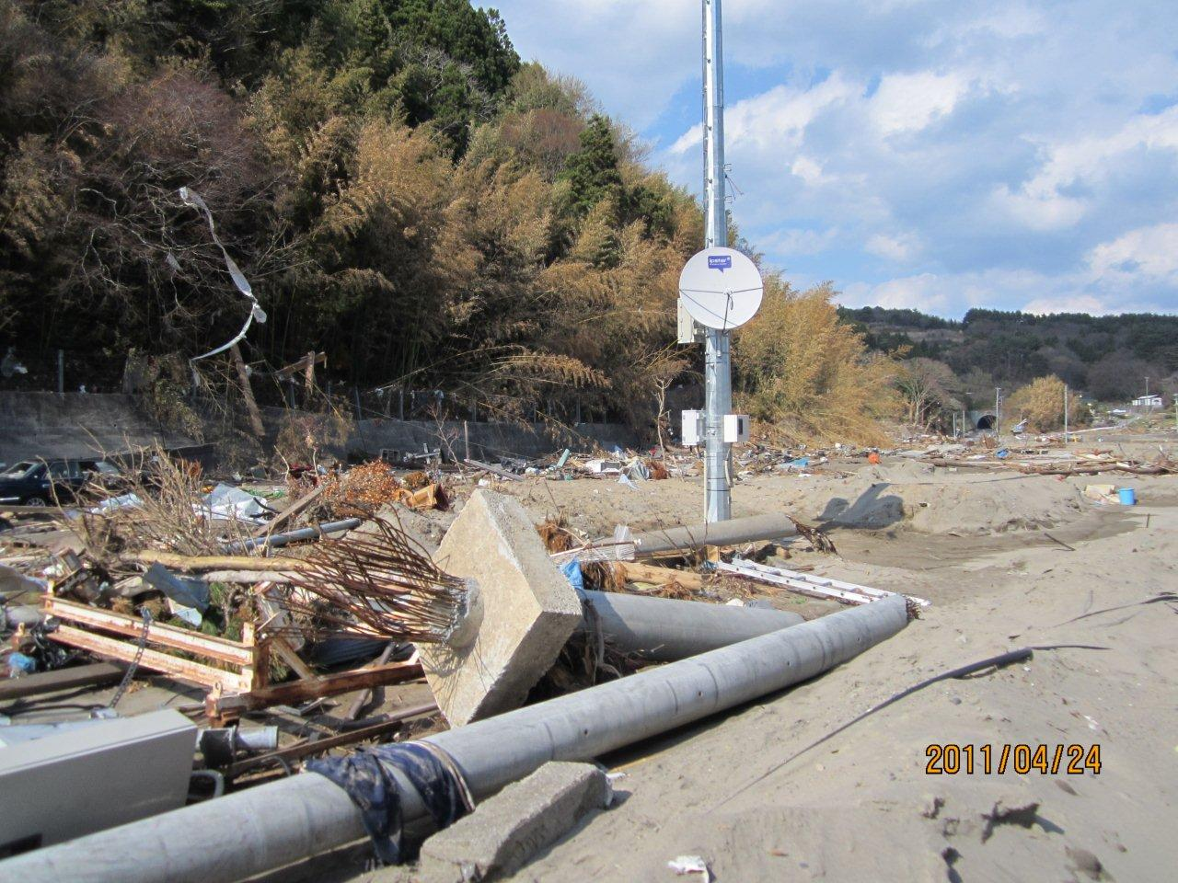
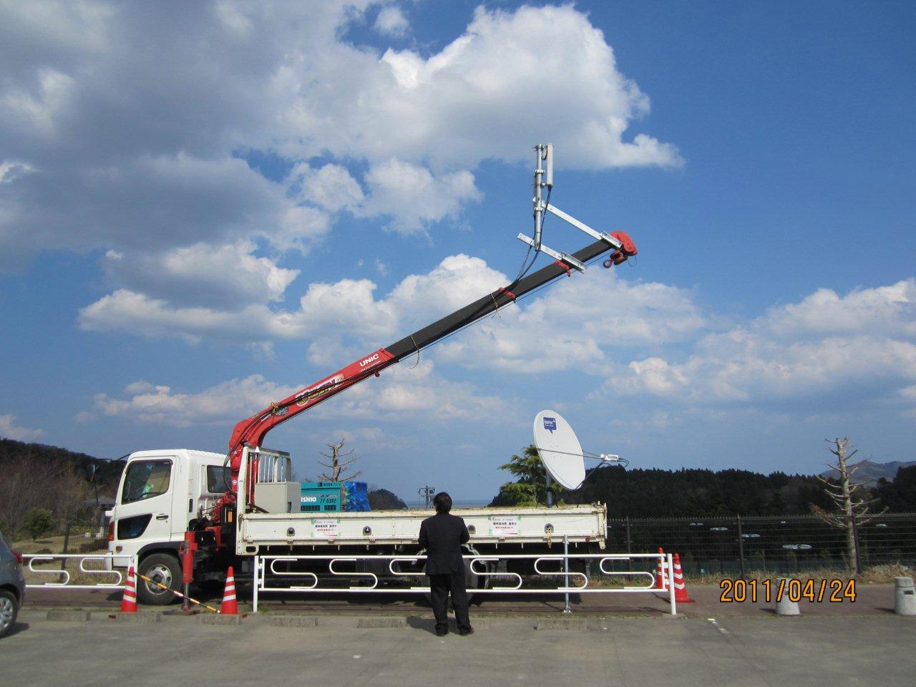

Slide 13
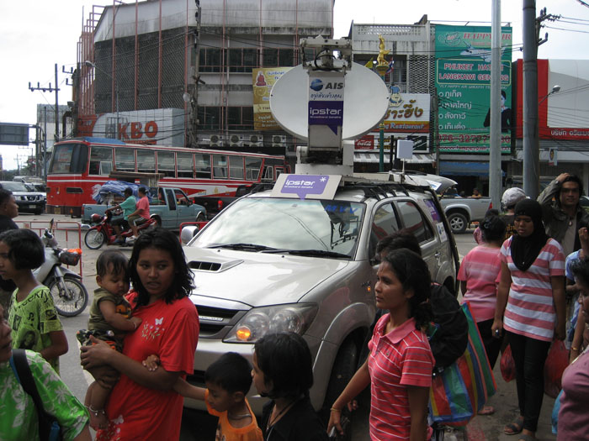
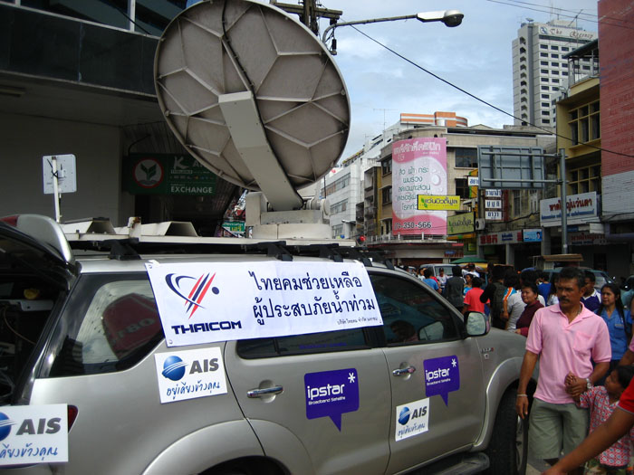
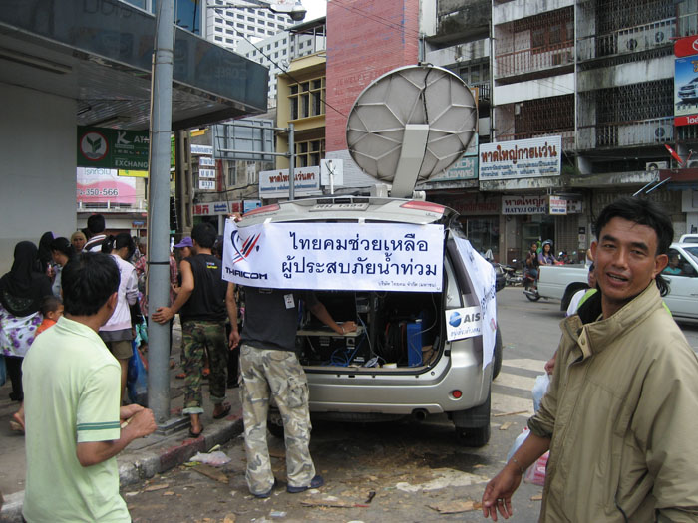
Temporary Cellular Phone Service using 2G Femtocell : Songkhla, Thailand
400 BTS, or more than 50% of the area in Songkhla province were cut due to the heavy flooding in southern of Thailand.
IPSTAR together with AIS provided temporary Mobile phone service using MVV and 2G Femtocell

Slide 14
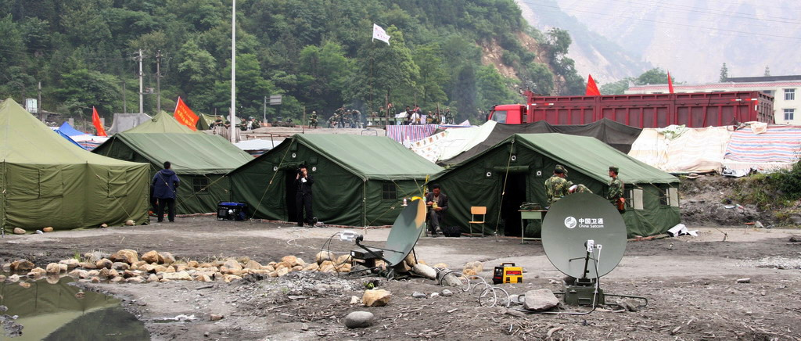
Case Study – Sichuan Earthquake in 2008

Slide 15
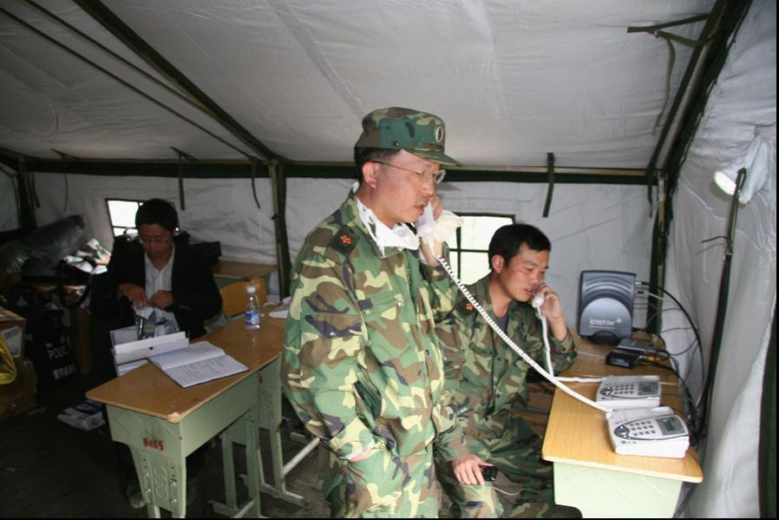
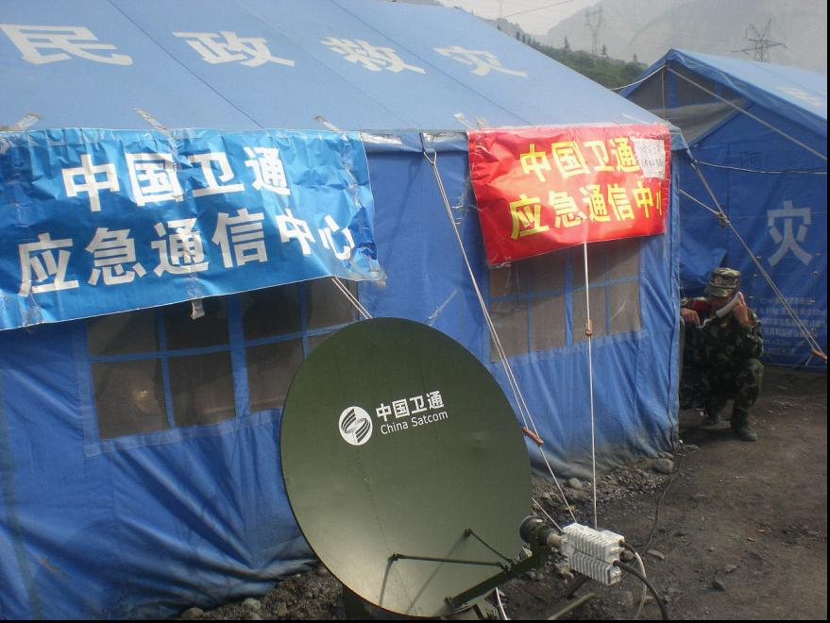
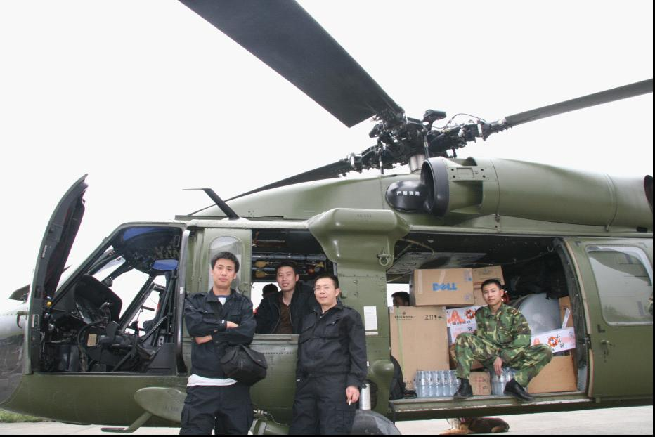

Emergency Communication Command Center
Two portable 1.2m antennas and IPSTAR user terminals served as the only communication tool for rescue operations
Two channels of live video were transmitted to the headquarter in Chengdu
Four IP phone sets were used for the army, rescue teams and the public

Slide 16
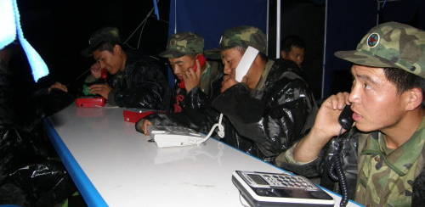
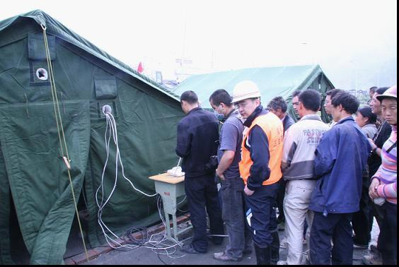
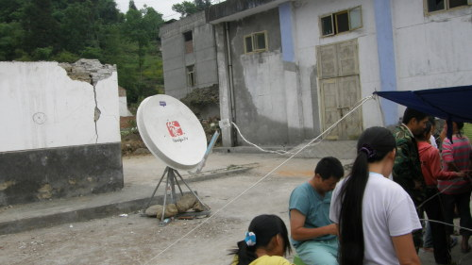
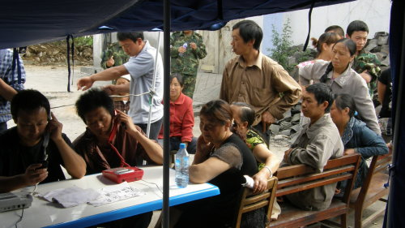
Public Telephone
Provision of free public telephone service
Became the only way to communicate with the outside world
Source: CBSN (IPSTAR’s partner in China)

Slide 17
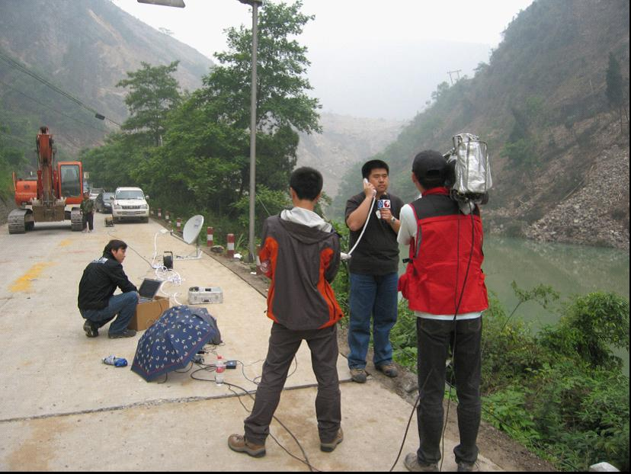
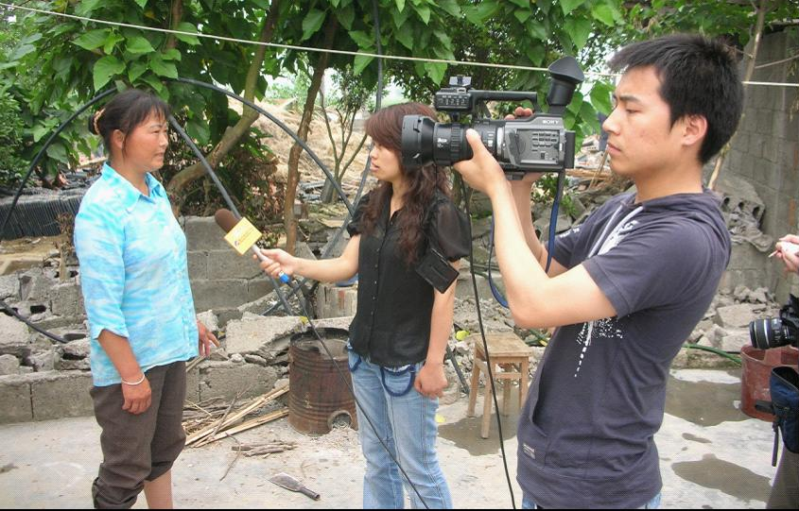
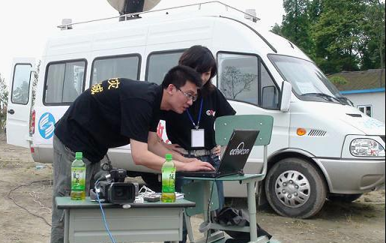
Providing Communications for the Media
On-site live broadcasting for 10 major TV channels, such as CCTV, Shanghai Media Group and Sichuan Media Group

Slide 18
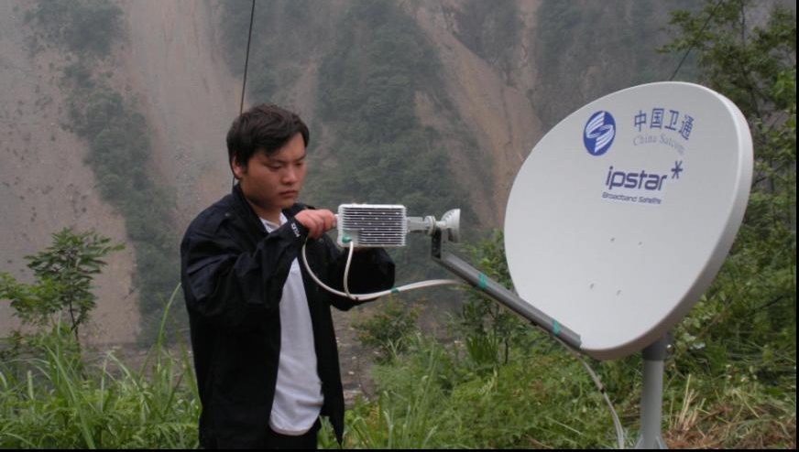
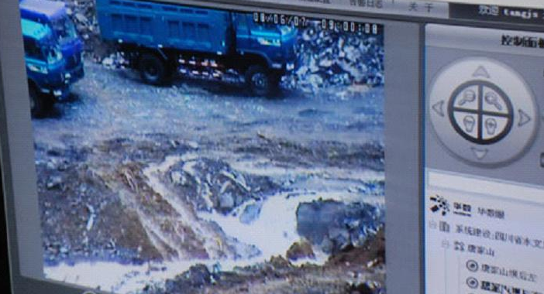
SCADA for Disaster Monitoring and Forecasting
10 satellite-monitoring sites were built at Tangjiashan Barrier Lake
Hydrological data and video were sent back to Mianyang and Beijing command centers to provide scientific, accurate data for quick decision-making and commanding.

Slide 19
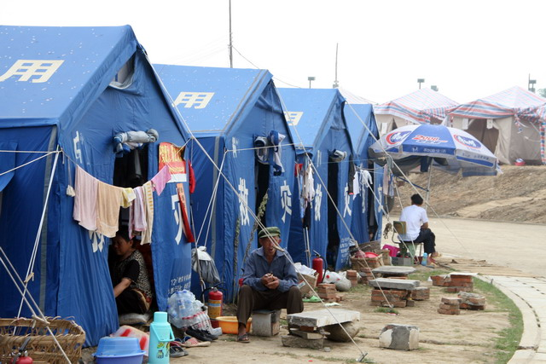
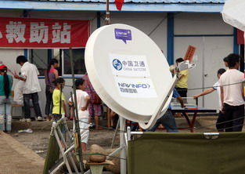
Communication Service for Temporary Residential Areas
Communication service to more than 20 temporary residential areas

Slide 20
Broadband Services Provided for Disaster Relief
Recovery services in the aftermath of the earthquake for a period of two months:
VoIP
Telephone service for rescue headquarters, government institutions and the public
Internet
For media organizations to transmit news and photos, and serving as a communication tool to the outside world
SNG
For TV Stations to provide on-site live broadcasting
Supervisory Control And Data Acquisition (SCADA)
Data acquisition and video monitoring in disaster-hit areas, and delivery of real-time information and live video for weather and aftershock forecasts

Slide 21
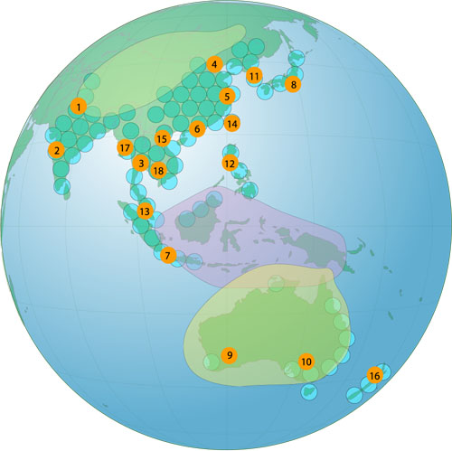
IPSTAR – Broadband Satellite for Asia-Pacific
World’s largest commercial satellite
(6.5 tons)
Broadband services and solutions for government, enterprise and consumers
Largest capacity (max. of 45 Gbps)
Serving 14 countries in Asia-Pacific
Covers 3.2 billion people (45% of the world’s population)
Serves up to 2 million broadband users
www.ipstar.com
Notes:
We are IPStar… Thank you…

